Slide 1
Enlarging Border Trade Potential through Investments
By
LIM Visal
Deputy Director of Public Relations and Promotion of Private Investment
Cambodian Investment Board
Council for the Development of Cambodia
Phnom Penh, September 12th 2017

Slide 2
1. Border Trade Potential
Potential of Border Trade
Length: ? km
Border Provinces: 7 each
Border Crossings: (Steung Bot 2020, upgrade 4 other)
Share of Border Trade: 60%
Committed Target
Total Trade: $15 Billion by 2020
To Enhance Border Trade:
Growth Strategy of Border Provinces’ Economic Cooperation
Physical Infrastructure
Soft Infrastructure:
Cooperation between border provinces:
Trade Fairs & Exhibitions
Investments
Agreement on Border Trade (16/02/2006)

Slide 3
2. Qualified Investment Projects (QIP)
Annex 1 of Sub-decree 111 (aka. Negative List):
Section 1: Investment Activities Prohibited by Laws:
Section 2: Investment Activities Not Eligible for Incentives:
01. All kinds of commercial activities, wholesales, retails …..;
14. Production of garments, textiles, footwear, hats, with investment capital less than USD 500,000;
21. Production of electrical and electronic appliances and office materials with investment capital less than USD 300,000;
40. Agricultural Production:
40.1 Paddy < 1,000 ha
40.2 Cash Crops <500 ha
40.3 Vegetable <5 ha
Section 3: Investment Activities Eligible for Customs Duties Exemption but not Profit Tax Exemption:

Slide 4
3. Investment Incentives and Guarantee
Investment Incentives
Corporate Tax: 20%
Tax holiday: up to 9 years
or
Special Depreciation
Full Import Duty Exemption
Construction materials
Machineries
Inputs (export-oriented)
Export Duty Exempt)
Suspension Import VAT
(inside SEZs)
Investment Guarantee
No discrimination
No nationalization
No requirements of local equity participation
No price controls on products or services
No restriction on foreign exchanges
No capital control

Slide 5
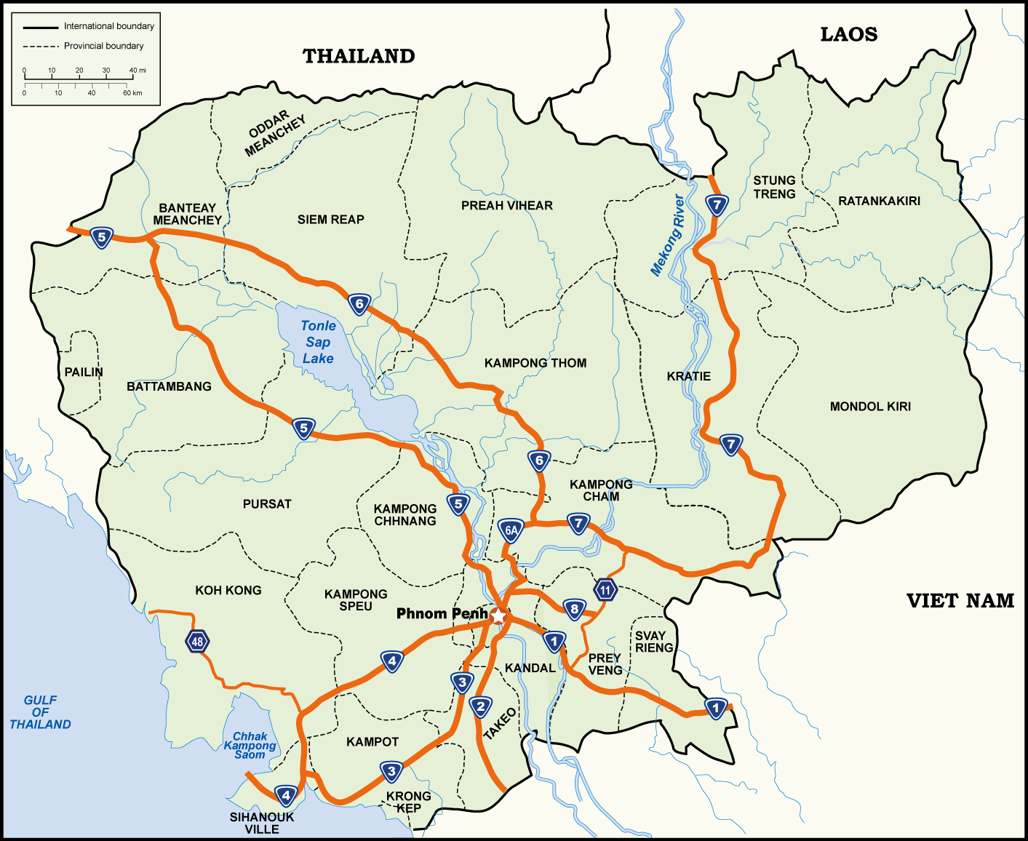
តំបន់សេដ្ឋកិច្ចពិសេសនៅកម្ពុជា
4. Cambodia’s Special Economic Zones
Poi Pet O'Neang SEZ
Sanco Poi Pet SEZ
Neang Kok Koh Kong SEZ
Phnom Penh SEZ
Kerry Worldbridge SEZ
Manhattan Svay Rieng SEZ
Tai Seng Bavet SEZ
Dragon King Bavet SEZ
Shandong Sunshell Svay Rieng SEZ
Hi-Park SEZ
Sihanoukville SEZ
Sihanoukville Port SEZ
Sihanoukville SEZ 1
H.K.T SEZ
Kampot SEZ

Slide 6
5. Flow Chart of Investment Application
Investment Application
Conditional Registration Certificate (3 working days)
or Letter of Refusal
One-Stop Meeting (Skip this step for garments & footwear)
Final Registration Certificate
+ relevant permits /registrations
(ex. Certificates of Incorporation, Tax Registration ….)

Slide 7
6. Checklist of Investment Application
Application Form
Company Statute
Feasibility Study
If shareholder is juridical person:
Power of Attorney
Statute of Parent Companies
Copy of Passport or ID Card
Letter of Indemnification (foreign shareholders)
Photo of Shareholders
Documents showing location and right to use (title, rental contract …)
Certificate of Deposit of 25% of registered capital from commercial banks

Slide 8
7. Time and Fee of Application
Prakas 992 dated 28/12/2012 by MEF and CDC:
Item | Service Fee (Riel) | Time (working day)
New Investment Project | 15,000,000 | 28
Site Inspection of New Project < 100 km 101 – 200 km > 200 km | 6,000,000 8,000,000 10,000,000
Duty Free Exemption Permit | 4,000,000 | 15
………..

Slide 9
8. Reasons to Invest in Cambodia
Open economy
Equal treatment of all investors
No requirement of local equity participation
No price controls on products or services
No restriction on foreign currencies convertibility
Competitive labor force
Reasonable wage: (minimum wage in 2017: $153)
Young and dynamic labor force (median age 24 years old)
Sound macroeconomic environment
6th fastest growing economy in the world during the last two decades (average growth rate: 7.7%)
Low & manageable inflation rate (under 5%)
Stable exchange rate (USD 1 = 4000 ± 5%)
Strategic location
Center of ASEAN and Mekong sub-region
Market access and Preferential trading status
ASEAN Market (AEC)
ASEAN + China, Japan, Korea, India, Australia & New Zealand (RCEP)
EU (EBA)
GSP: 32countries
MFN: WTO members
Competitive investment incentives
Low corporate tax: 20%
Tax holiday: 0% up to 9 years
Full import duty exemption (production equipment and machineries, contraction material, production inputs)
One stop service
Information & Application
Fast-Track Investment Approval Process: all documents will be processed within only 28 working days.
Customs Duty & Tax Exemption
Visa & Work Permit
EU (EBA)

Slide 10
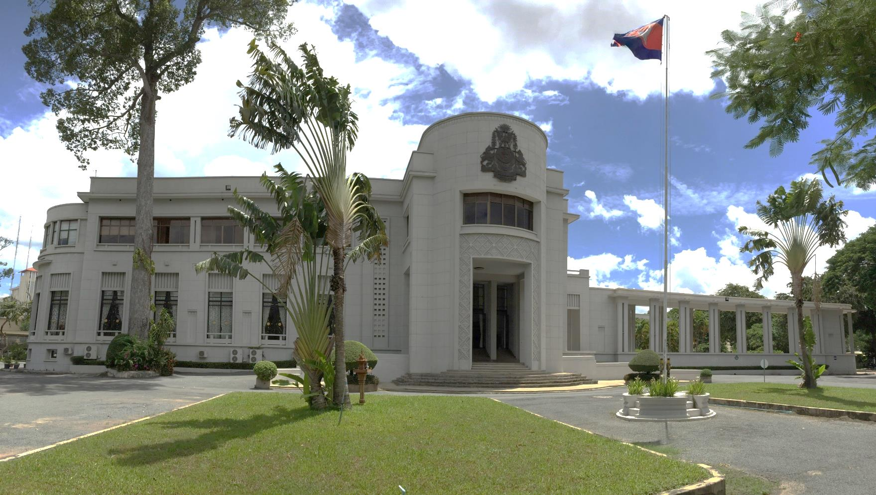
Thank You.
For more info, lvisal@yahoo.com

