Slide 1
Seminar on Enlarging Border Trade Potential
between Cambodia and Thailand
12 September 2017, Cambodiana Hotel, Phnom Penh
Transport Sector
Infrastructure
and
Cross-Border Transport
1

Slide 2
CONTENTS
Infrastructure Development
Transport Facilitation Agreements
(Cambodia-Thailand Cross-Border Transport)
2

Slide 3
I. Infrastructure Development
3

Slide 4
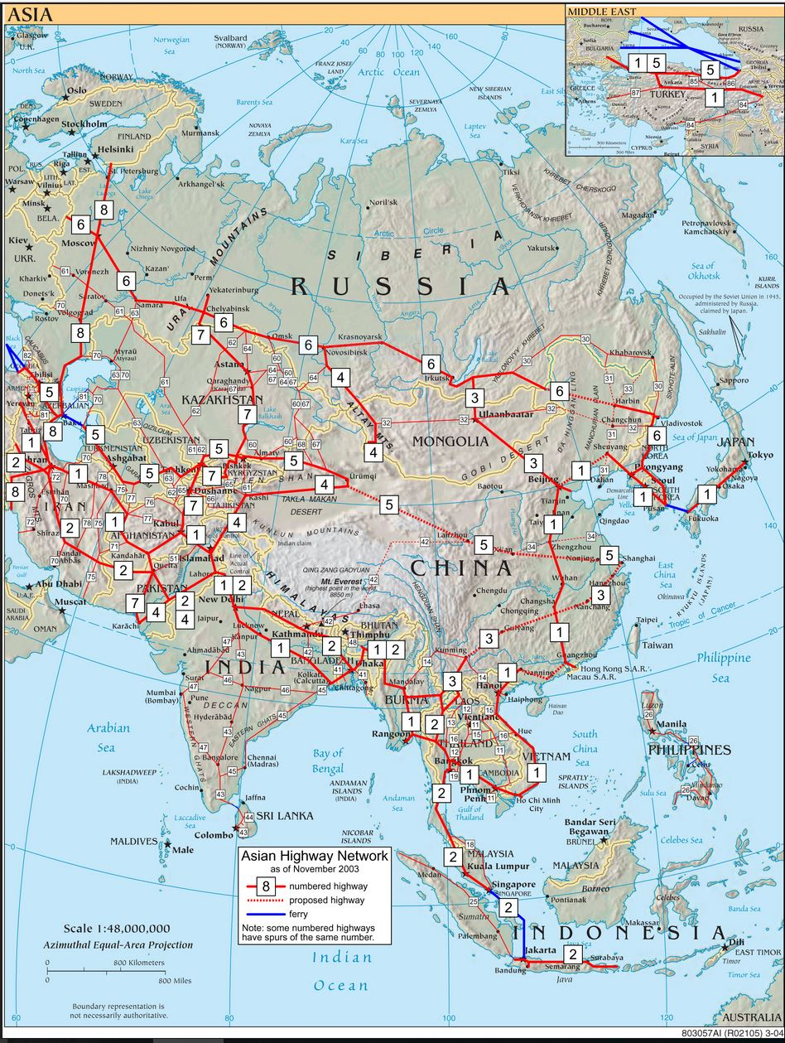
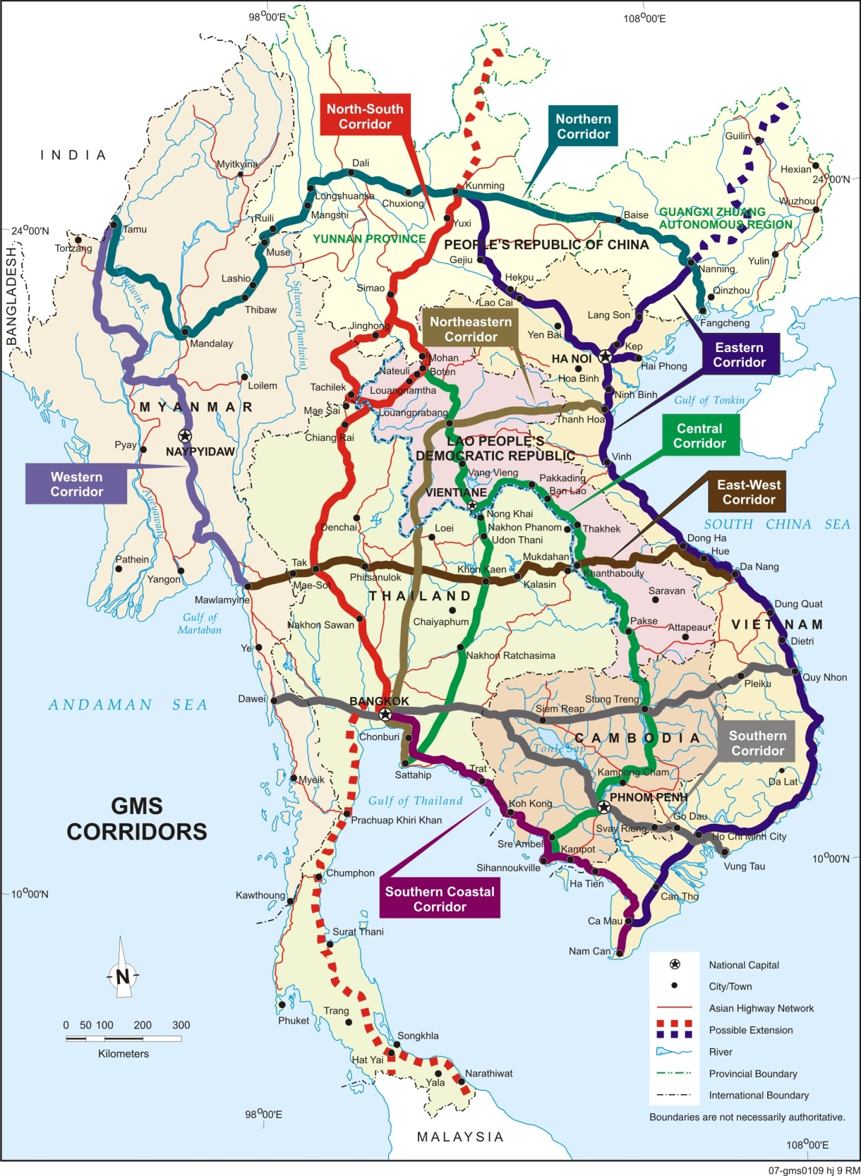
I. Infrastructure Development
Asian Highway Network/GMS Economic Corridor
4

Slide 5
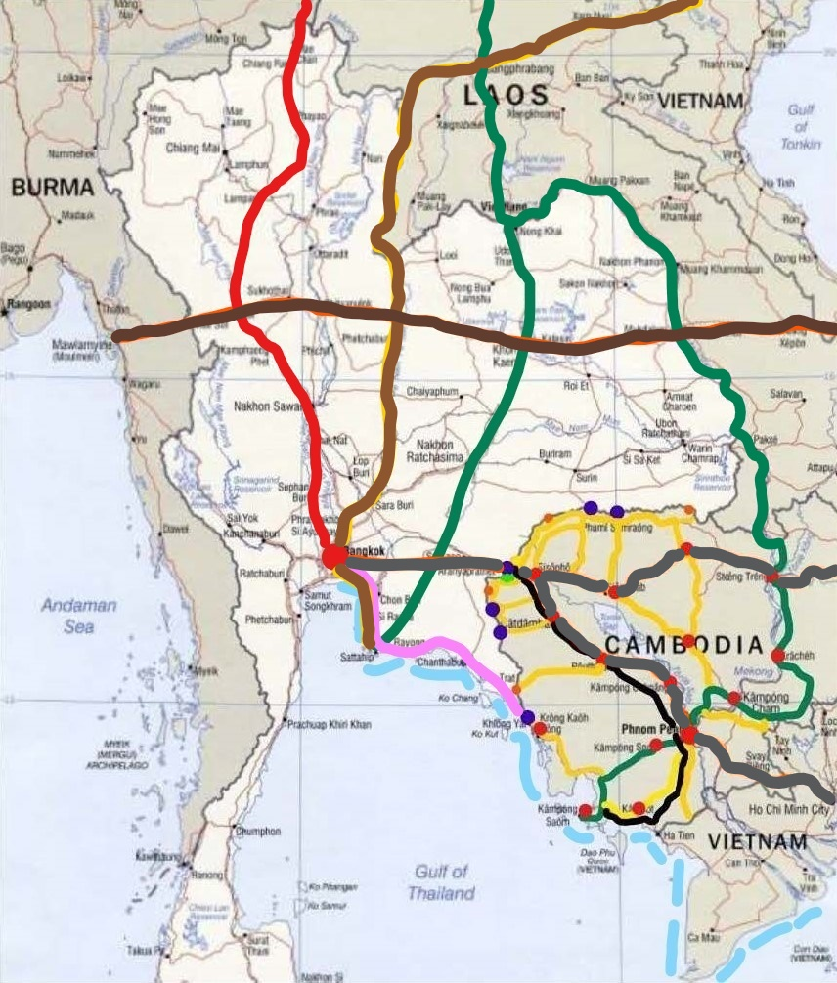
I. Infrastructure Development
GMS Economic Corridor/Cambodia – Thailand
5

Slide 6
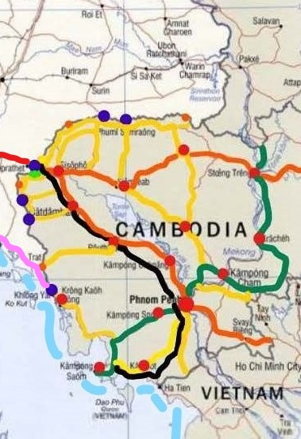
I. Infrastructure Development
Cambodia – Thailand Enlarging Cross Border
Poipet - Aranyaprathet International Border Check Point is a main gate for GMS Connectivity, but it’s too narrow.
New International Border Check Point
Stung Bot - Ban Nong Ian:
Border Bridge was started pile driving. (Thailand Grant)
Border Control Facilities and Access Road to NR. No. 5 will commence to construct in early 2018 and will be completed by 2020 (Thailand Soft Loan)
6

Slide 7
I. Infrastructure Development
Cambodia – Thailand Enlarging Cross Border Cont’
Propose to open a new Int. Border Check Point O’ Neang – Ban Pa Rail
at the earliest opportunity.
Joint Detail Survey (JBC) at Chhoak Roka (Samlot Battambang) – Ban Mamuang (Borai Trat)
The 04 border Points of entry will be upgraded to Int. point of entry:
An Ses (Preah Vihea) – An Ma (Ubon Rachathani)
Chup Koki (Odd Meanchey) – Sai Taku (Boriram)
Phnom Dei (Battambang) – Ban Khao din (Sa Kaeo)
Thmor Da (Pursat) - Ban Tha Sen (Trat)
Notes: On Other (Existing) International Border Check Points:
Chorm – Sa Ngam 2. O Smach – Chong Chom
3. Daung – Ban Lem 4. Prom – Ban Pak Kard,
Joit Survey (JBC) for new Border Bridge Construction.
5. Cham Yeam – Hat Lek.
7

Slide 8
I. Infrastructure Development
Cambodia – Thailand Enlarging Cross Border Cont’
National Road No. 5 is under upgrading:
from 2 lanes to 4 lanes with median. Total length 364 Km from Prek Kdam to Poi Pet.
will be completed in 2021
Rail Link from Poipet - Aranyaprathet (border check point) to Phnom Penh. MPWT committed to complete by the end of 2020.
Coastal Shipping Development:
between Thailand – Cambodia – Viet Nam has
built the outcomes to promote and develop
maritime transport in the region (1^{rst}.meeting
in 2016 in Thailand)
8

Slide 9
II. Transport Facilitation Agreements
9

Slide 10
II.1 Cambodia-Thailand Cross-Border Transport Facilitation Agreement between
Both countries signed a MOU on the Exchange of Traffic Rights in 30 March 2008 (become effective 90 days after the date of signing):
Each country can issue total number of quota upto 40 for Non-schedule Passenger Transportation and Cargo Transportation at Poipet-Aranyaprathet border check points and designated routes as specified in Protocol 1 of GMS CBTA,
It’s considered as the Initial Implementation of CBTA (IICBTA), not Bilateral Agreement.
However, the implementation of this MOU has begun only from June 2012.
On 16 December 2016 in Chiang Mai, the two parties signed the Addendum Two to the MOU to increase the number of quota from 40 to 150.
As of today only 44 buses from Cambodia are registered. ?
10

Slide 11
II.1 Cambodia-Thailand Cross-Border Transport Facilitation Agreement between
Challenges in implementation of this Agreement:
Because this is IICBTA, then the Routes and Entry/Exit Points are limited as agreed in Protocol 1 of CBTA, No ways to open more routes nor more border check points
Unbalance flow of goods, more import less export (5/1)
Conditions of transport in Thailand are not favorable for Cambodian operators such as,
Limit the maximum length of Semi-trailers is only 13.60m
Not allow goods in transit in Thailand
Not allow unladen (empty) trucks enter Thailand
Driving on different side
For the Railway Transport, Both countries will signed a MOU on the “Joint Traffic Working over Railway” in 2017
11

Slide 12
Thank you
12

